Slide 1
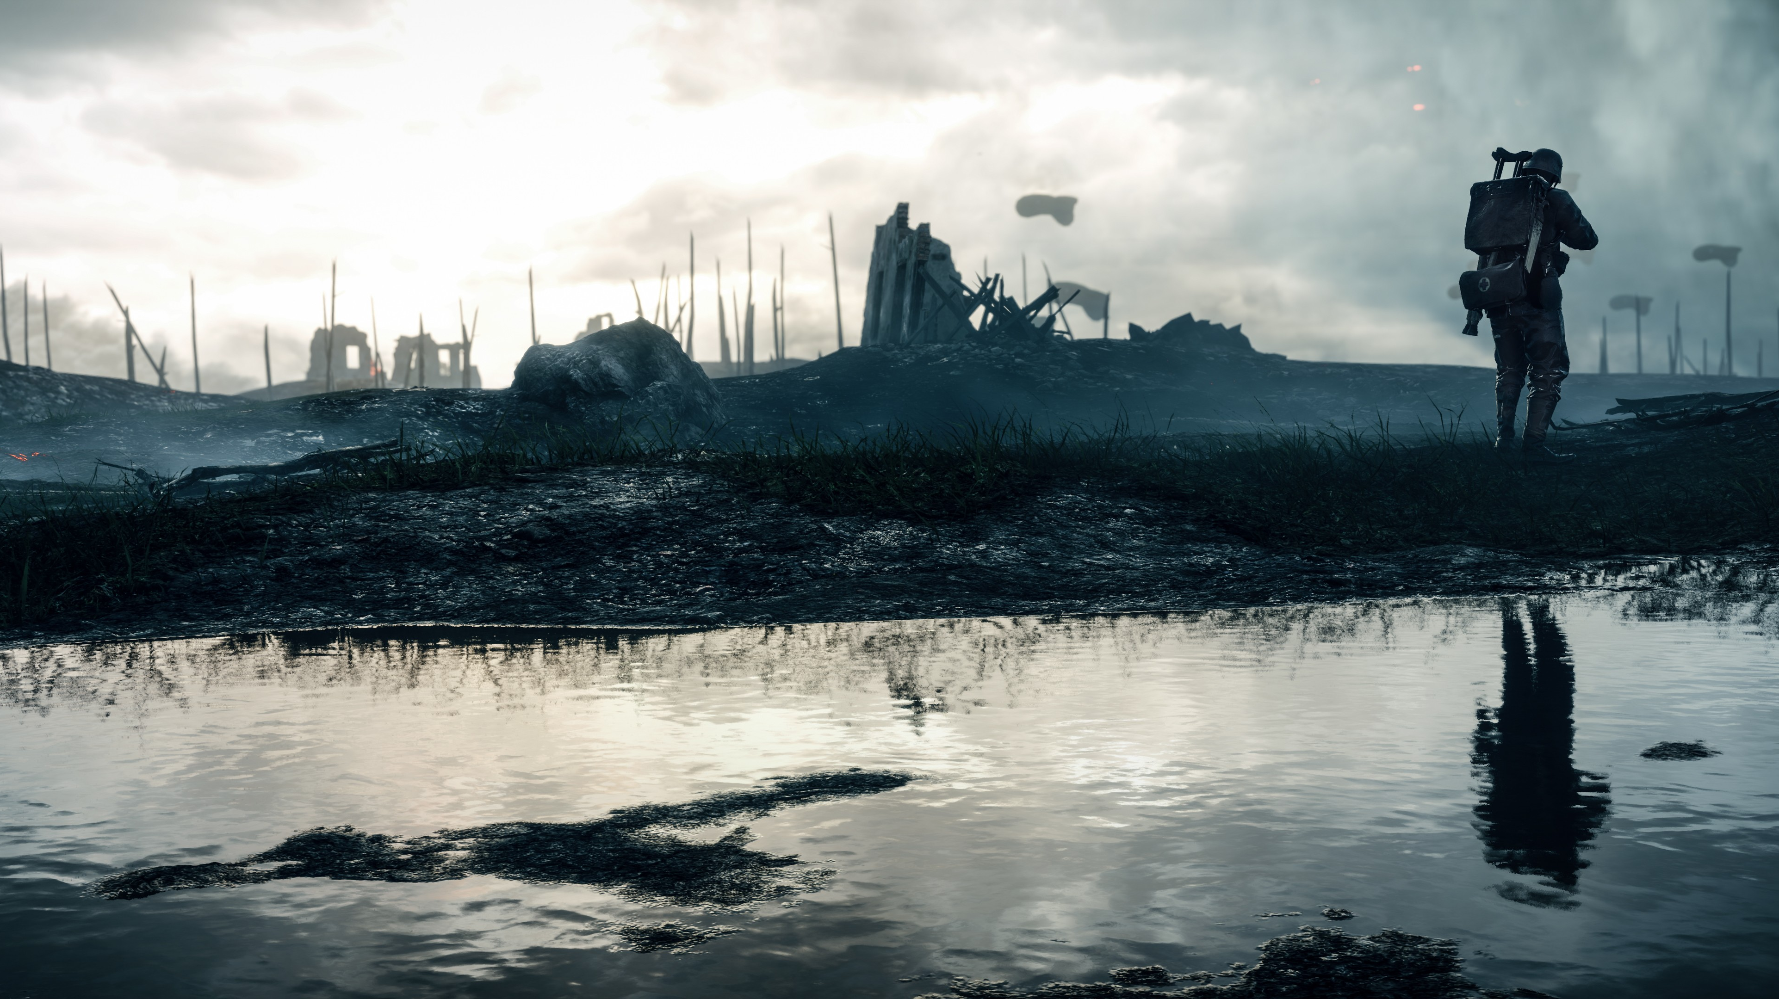
DATA ANALYSIS OF
THE WORLD WARS

Slide 2
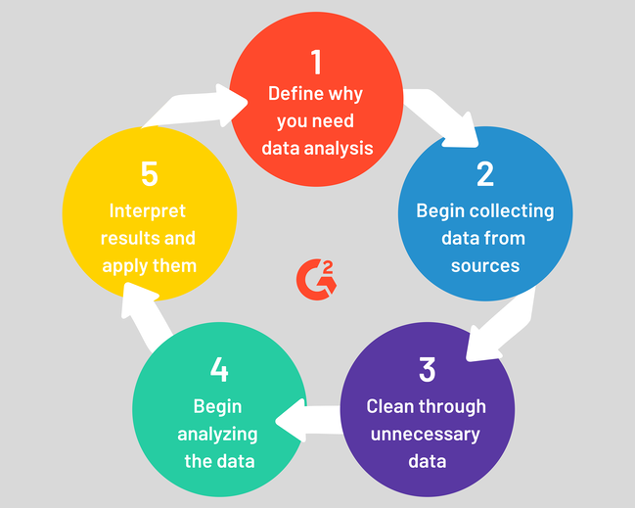
Overview of
Data Analysis Process:

Slide 3
ABSTRACT:
The art of war is of vital importance to the Country. It is a matter of life and death, a road either to safety or to ruin. Hence it is a subject of inquiry which can on no account be neglected. The two World Wars had a significant impact on the World. The race for the arms has been a constant motivation for the advancement in technology by pursuing science.
Our task at hand is to assess the Data from the two major wars in the history of mankind. We approach it by minimalizing the data and categorizing it. We then visualize the data on the world map and in the form of bar charts, bubble charts and comparison of the Wars in the categories of Death Count, Ammunition used, Soldier count, Country count.

Slide 4
AIM:
With the help of this project we plan to visualize the effect of world war on countries, regions and even continents. The project also helps to visualize the effect and indirect involvement of countries like India, Australia, New Zealand, though they were way apart from the battle field. The reason could be different for each country in this case, like for India it was because of British Empire ruling India during both wars.

Slide 5
MODULES USED
PANDAS
CSV
NUMPY
CUFFLINKS
MATHPLOTLIB

